Slide 1

IOT-GREENHOUSE CLIMATE CONTROL
Students: Nedealcova Irina, Bujilov Dmitrii, Cravcenco Dmitrii, Ciornii Alexandr
Group: FAF-223
Superviser: Bragarenco Andrei, lect. PhD

Slide 2

Table of Contents
Problem Definition
Our Solution
Example of IoT Smart Greenhouse
The Future of IoT in Agriculture
Stakeholders Map
Our Solution Includes
Main Components
Priority System Requirements
How It Works
Conclusion

Slide 3

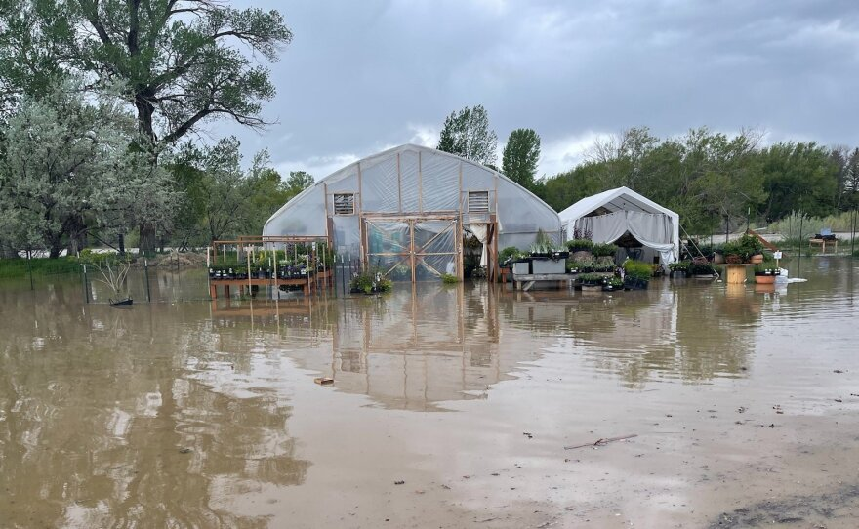
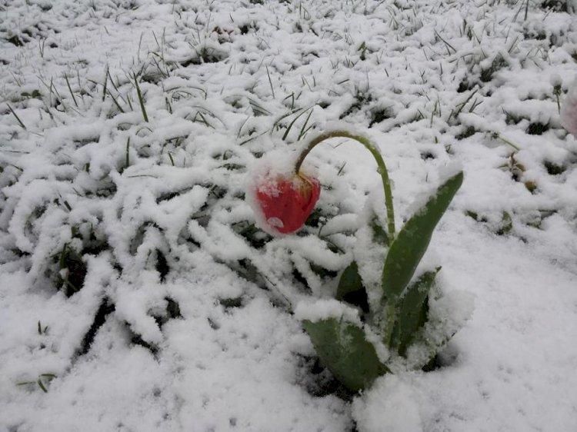
Problem Definition
Our agriculture is challenged by both the impact of weather events like floods, frosts, and hail, and the complex management required for temperature, humidity, light, and CO₂ control.

Slide 4
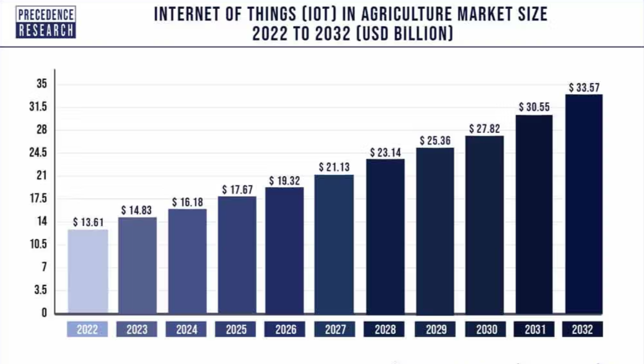
The Future of IoT in Agriculture

Slide 5

Our Solution
An IoT-enabled, autonomous system designed to optimize greenhouse climate conditions.
Key Goals:
Boost plant growth with stable conditions
Auto-adjust climate using live data
Enable remote monitoring and alerts

Slide 6
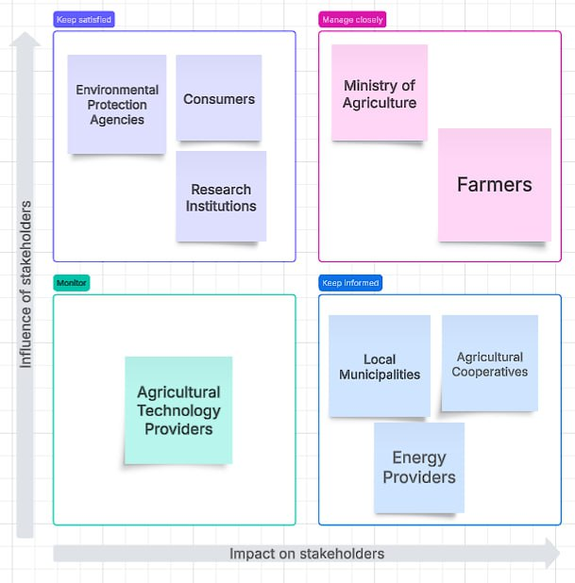

Stakeholders map

Slide 7
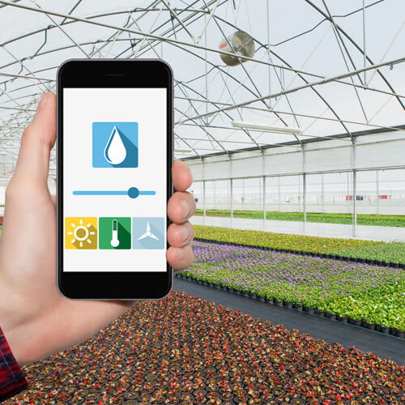
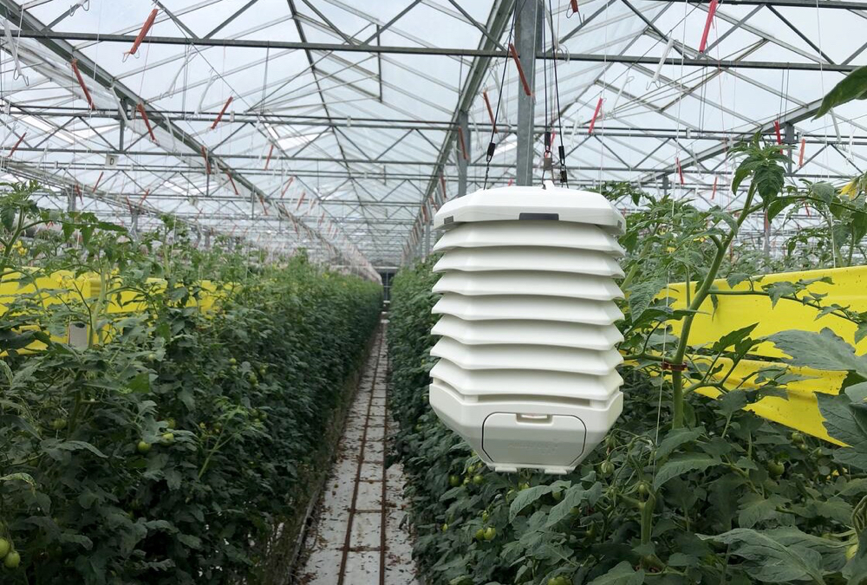
Our solution includes
Sensors
Automated Controls
Data Processing
Remote Access & Alerts

Slide 8
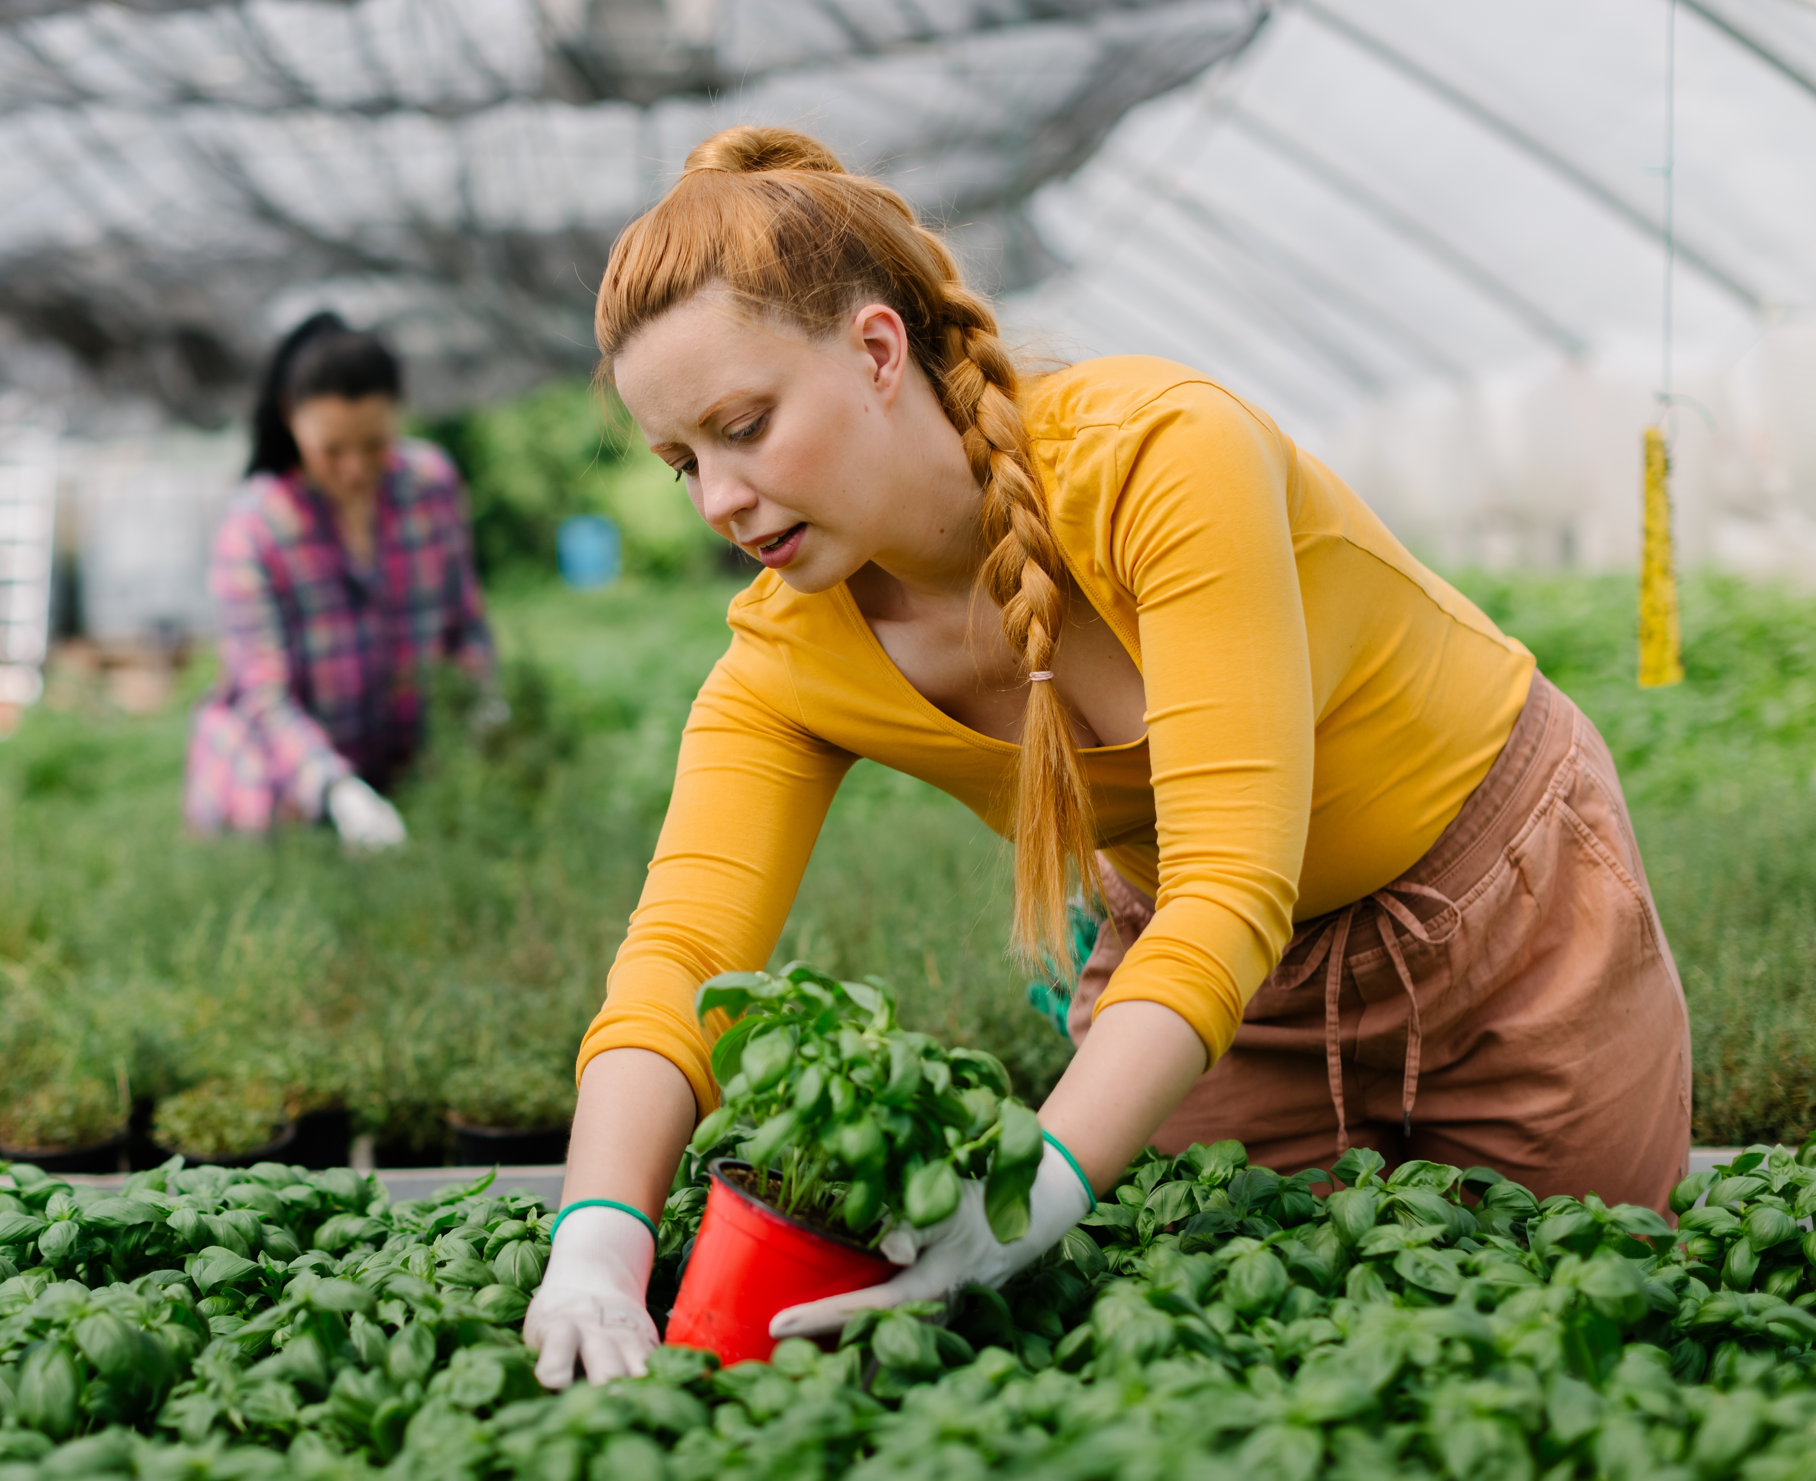
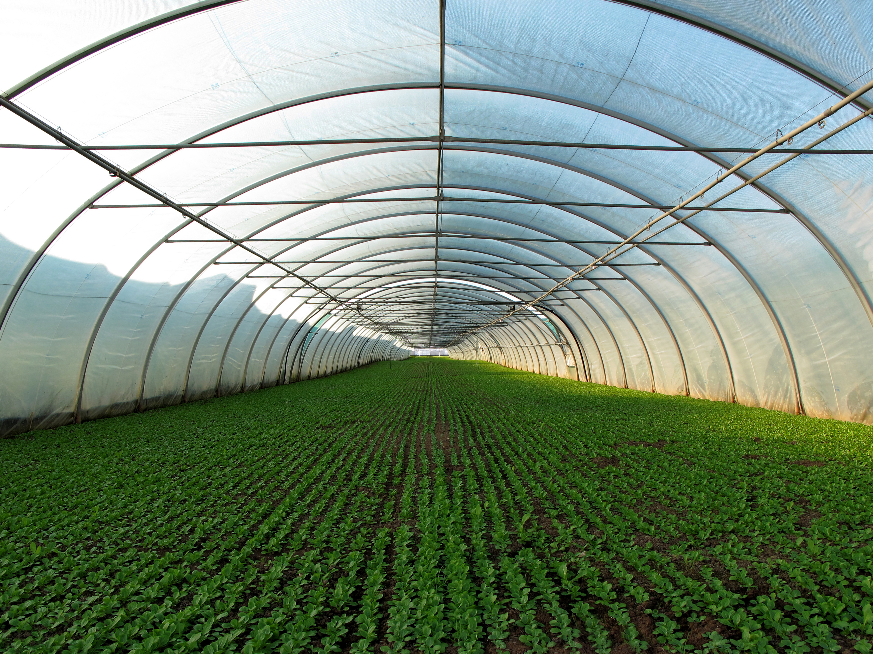
Priority System Requirements:
Automated climate control
Real-time monitoring
System failure notifications
Balance accuracy with efficiency
Energy optimization
Integration with existing systems
Minimal error rates
Configurable climate parameters

Slide 9
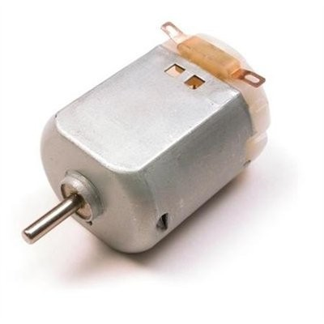
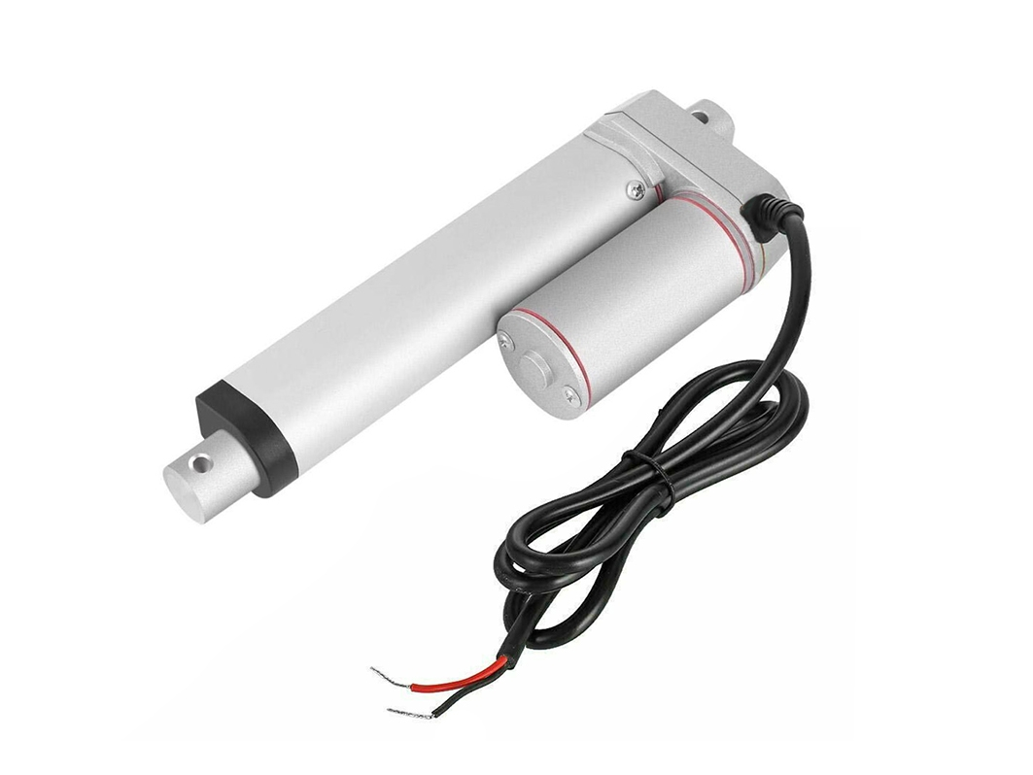
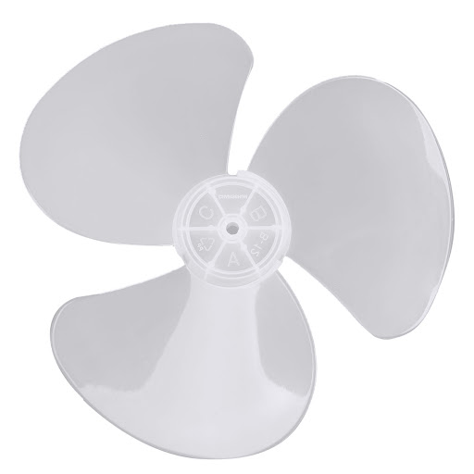
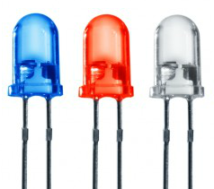
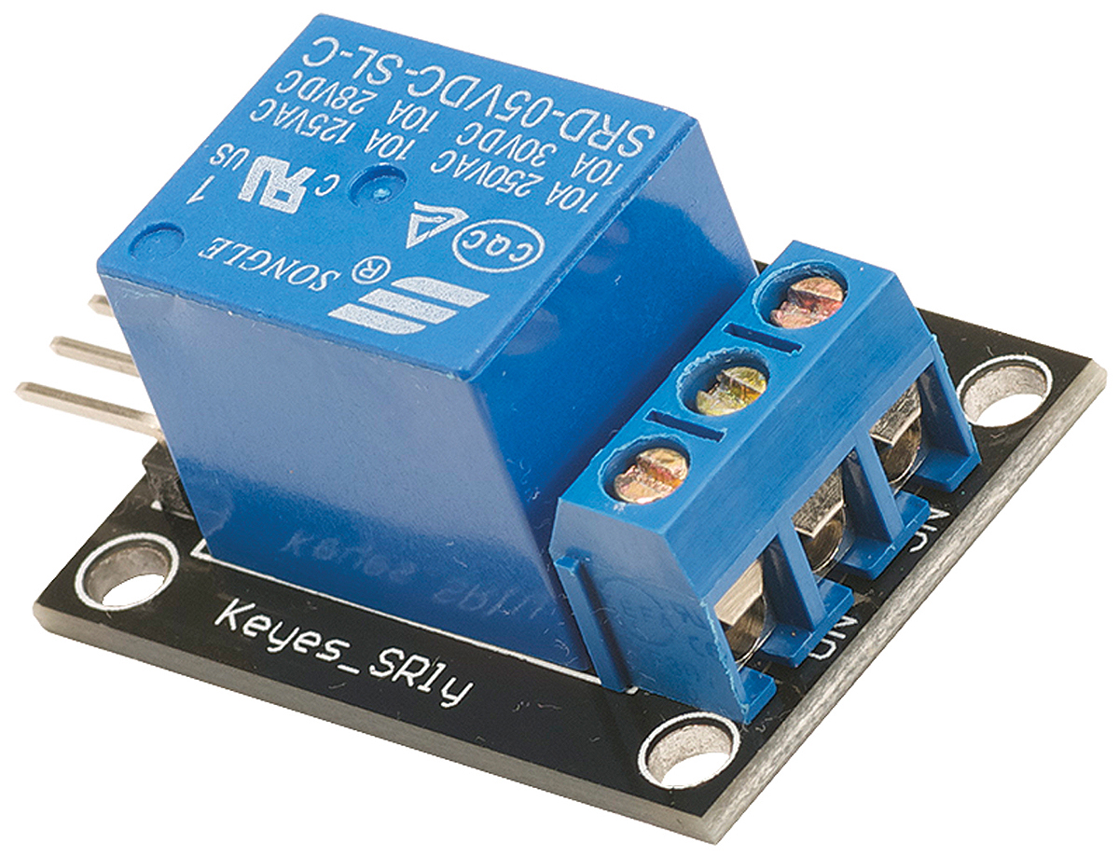
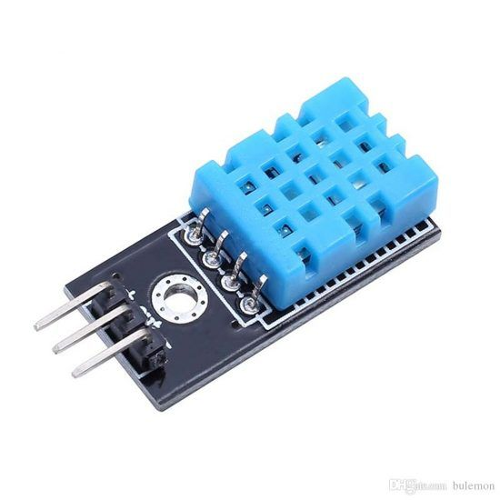
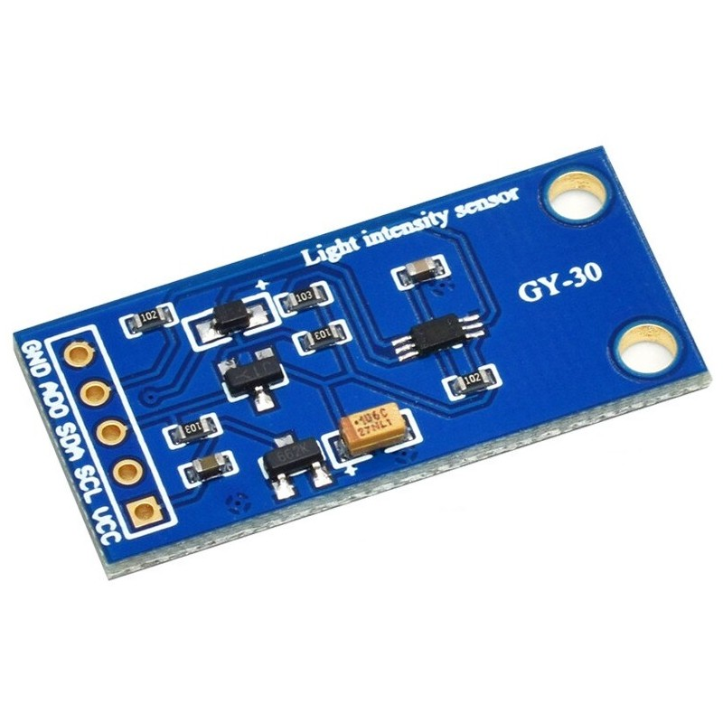
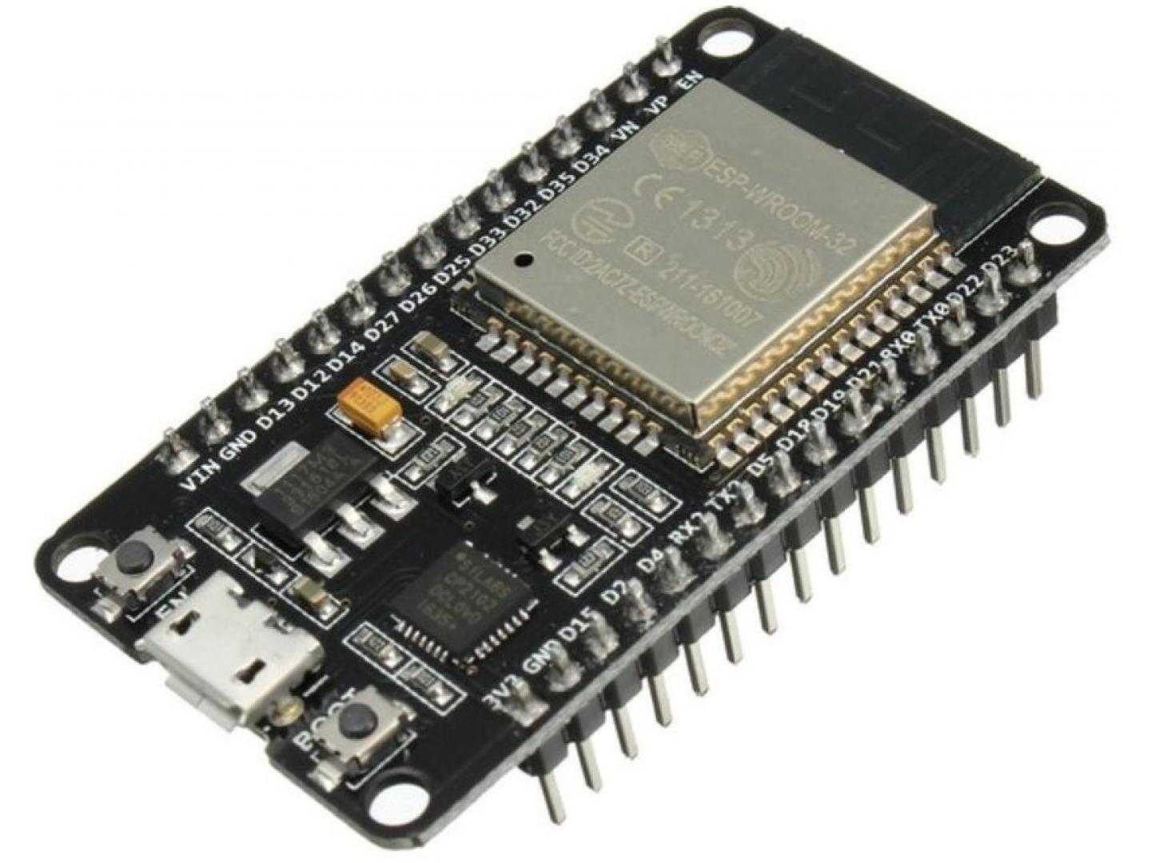
DC Motor Linear Actuator LED Relay Module
DHT 11 Light Sensor ESP 32

Slide 10
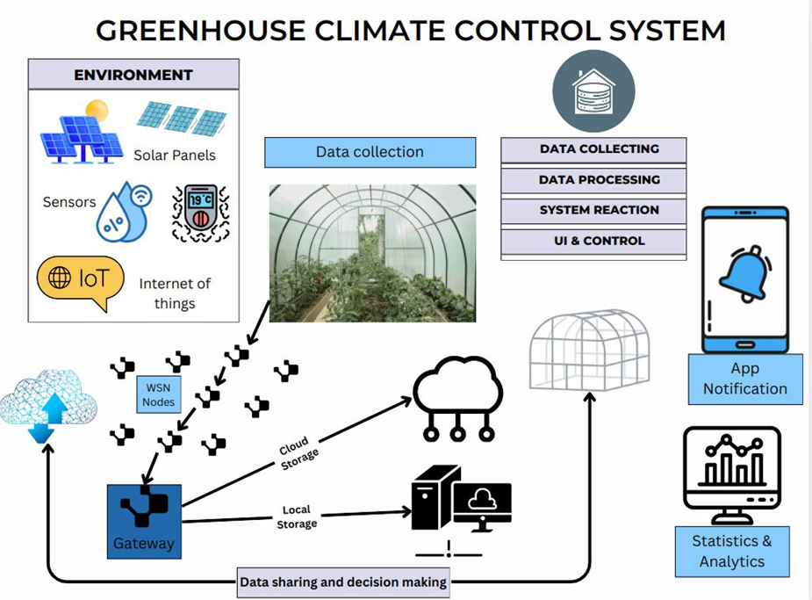

Slide 11
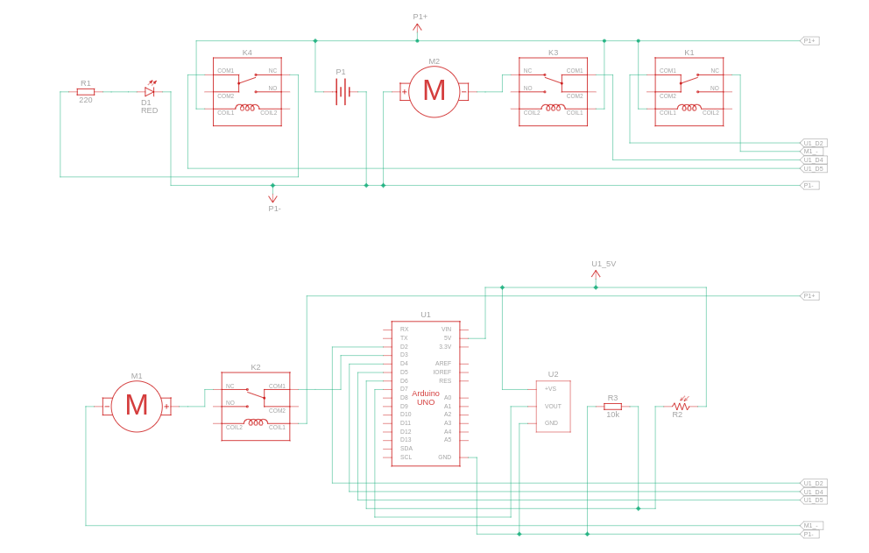
Electronic sketch

Slide 12
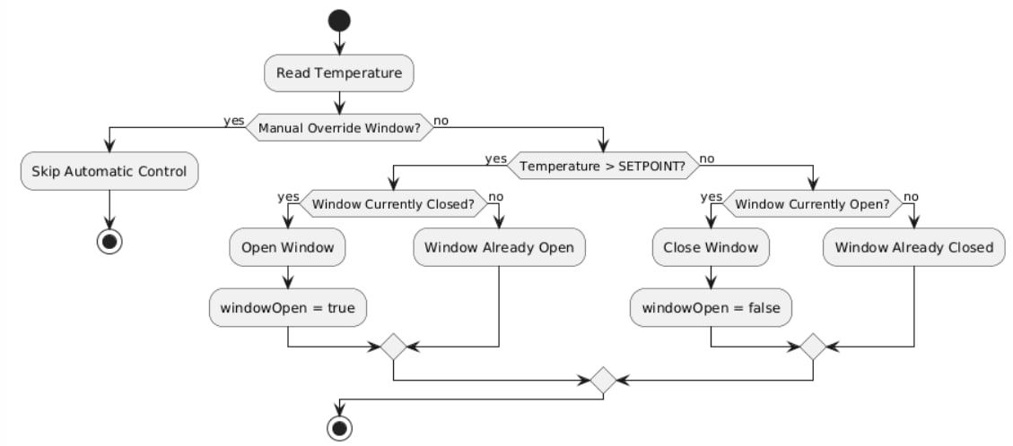
Temperature control flowchart diagram

Slide 13
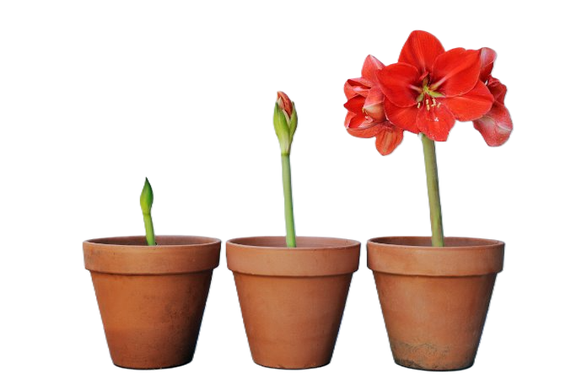
Conclusion
Our smart greenhouse system helps Moldovan farmers grow more food with less work. It controls the climate on its own and uses fewer resources. This makes farming easier even when weather is bad.
"GROWING SMARTER, HARVESTING BETTER."

Slide 14
LIVE DEMO TIME
https://gcc-gray.vercel.app

